Slide 1
Machine Learning
Lecture 20: Review
Dr. Beilun Wang
Southeast University
School of Computer Science
and Engineering

Slide 2
Final Review
Five Tribes of Machine Learning
Review of ML methods covered so far
Regression (supervised)
Classification (supervised)
Unsupervised models
Learning theory

Slide 3
Traditional Programming v.s. Machine Learning
Traditional Programming
Data Algorithm
Computer
Output
Machine Learning
Data Output
Computer
Algorithm
/ Model

Slide 4
Objective
To help students be able to build machine learning tools
Key Results:
Able to build a few simple machine learning methods from scratch
Able to understand a few complex machine learning methods at the source code and equation level

Slide 5
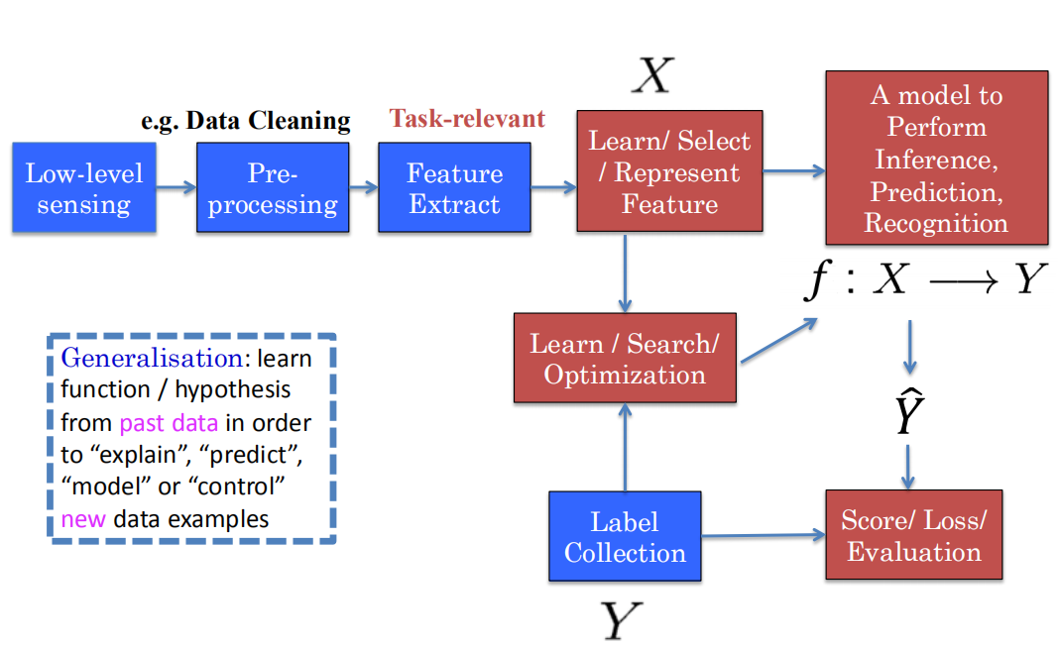
Typical ML Application’s Pipeline

Slide 6
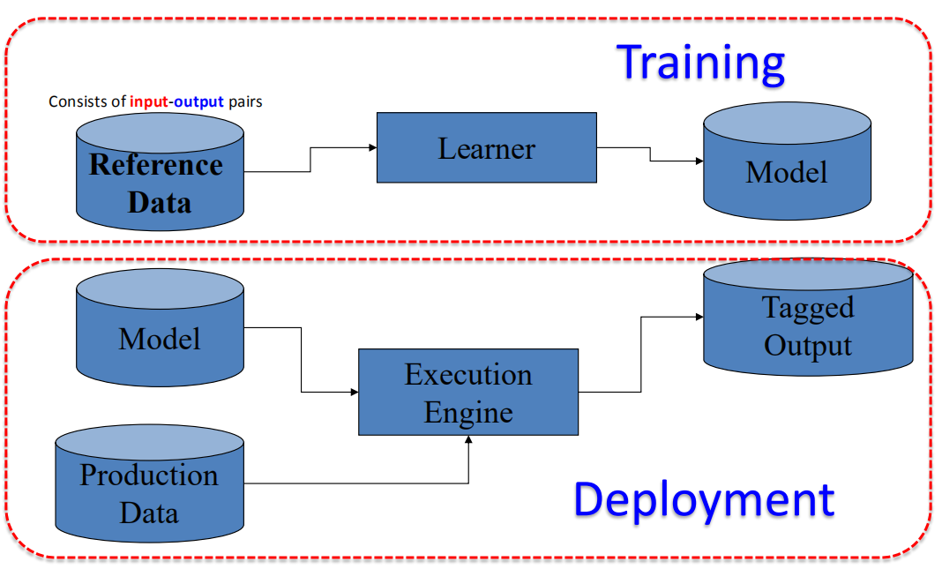
Two Modes of Machine Learning

Slide 7
Course Content Plan
Regression (supervised)
Classification (supervised)
Unsupervised models
Dimension Reduction (PCA)
Clustering (K-means, GMM/EM, Hierarchical )
Learning theory
Y is a continuous
Y is a discrete
NO Y
About f()
Graphical models
About interactions among X1,… Xp
Reinforcement Learning
Learn program to Interact with its environment

Slide 8

Scikit-learn algorithm cheat-sheet
http://scikit-learn.org/stable/tutorial/machine_learning_map/

Slide 9
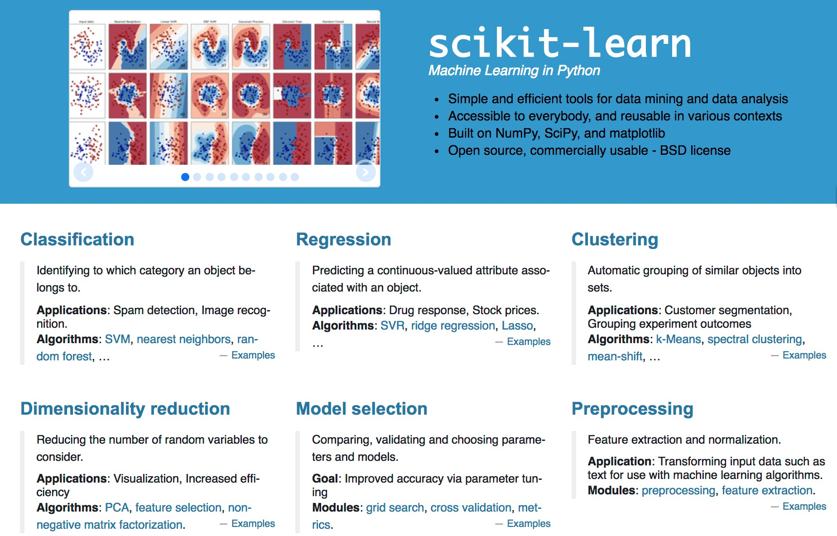
http://scikit-learn.org/stable/

Slide 10
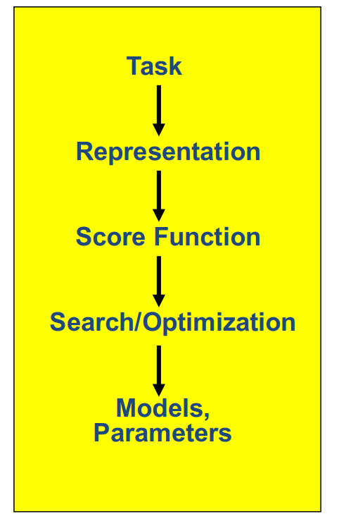
Machine Learning in a Nutshell
ML grew out of work in AI
Optimize a performance criterion using example data or past experience
Aiming to generalize to unseen data

Slide 11
The Five Tribes of Machine Learning
Tribe | Origins | Key Algorithm
Symbolists | Logic, philosophy | Inverse deduction
Connectionists | Neuroscience | Backpropagation
Evolutionists | Evolutionary biology | Genetic programming
Bayesians | Statistics | Probabilistic inference
Analogizers | Psychology | Kernel machines
SRC: Pedro Domingos ACM Webinar Nov 2015 http://learning.acm.org/multimedia.cfm

Slide 12

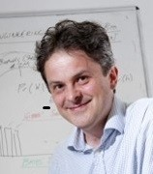
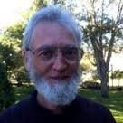
Symbolists
Tom Mitchell
Steve Muggleton
Ross Quinlan
Tribe | Origins | Key Algorithm
Symbolists | Logic, philosophy | Inverse deduction

Slide 13
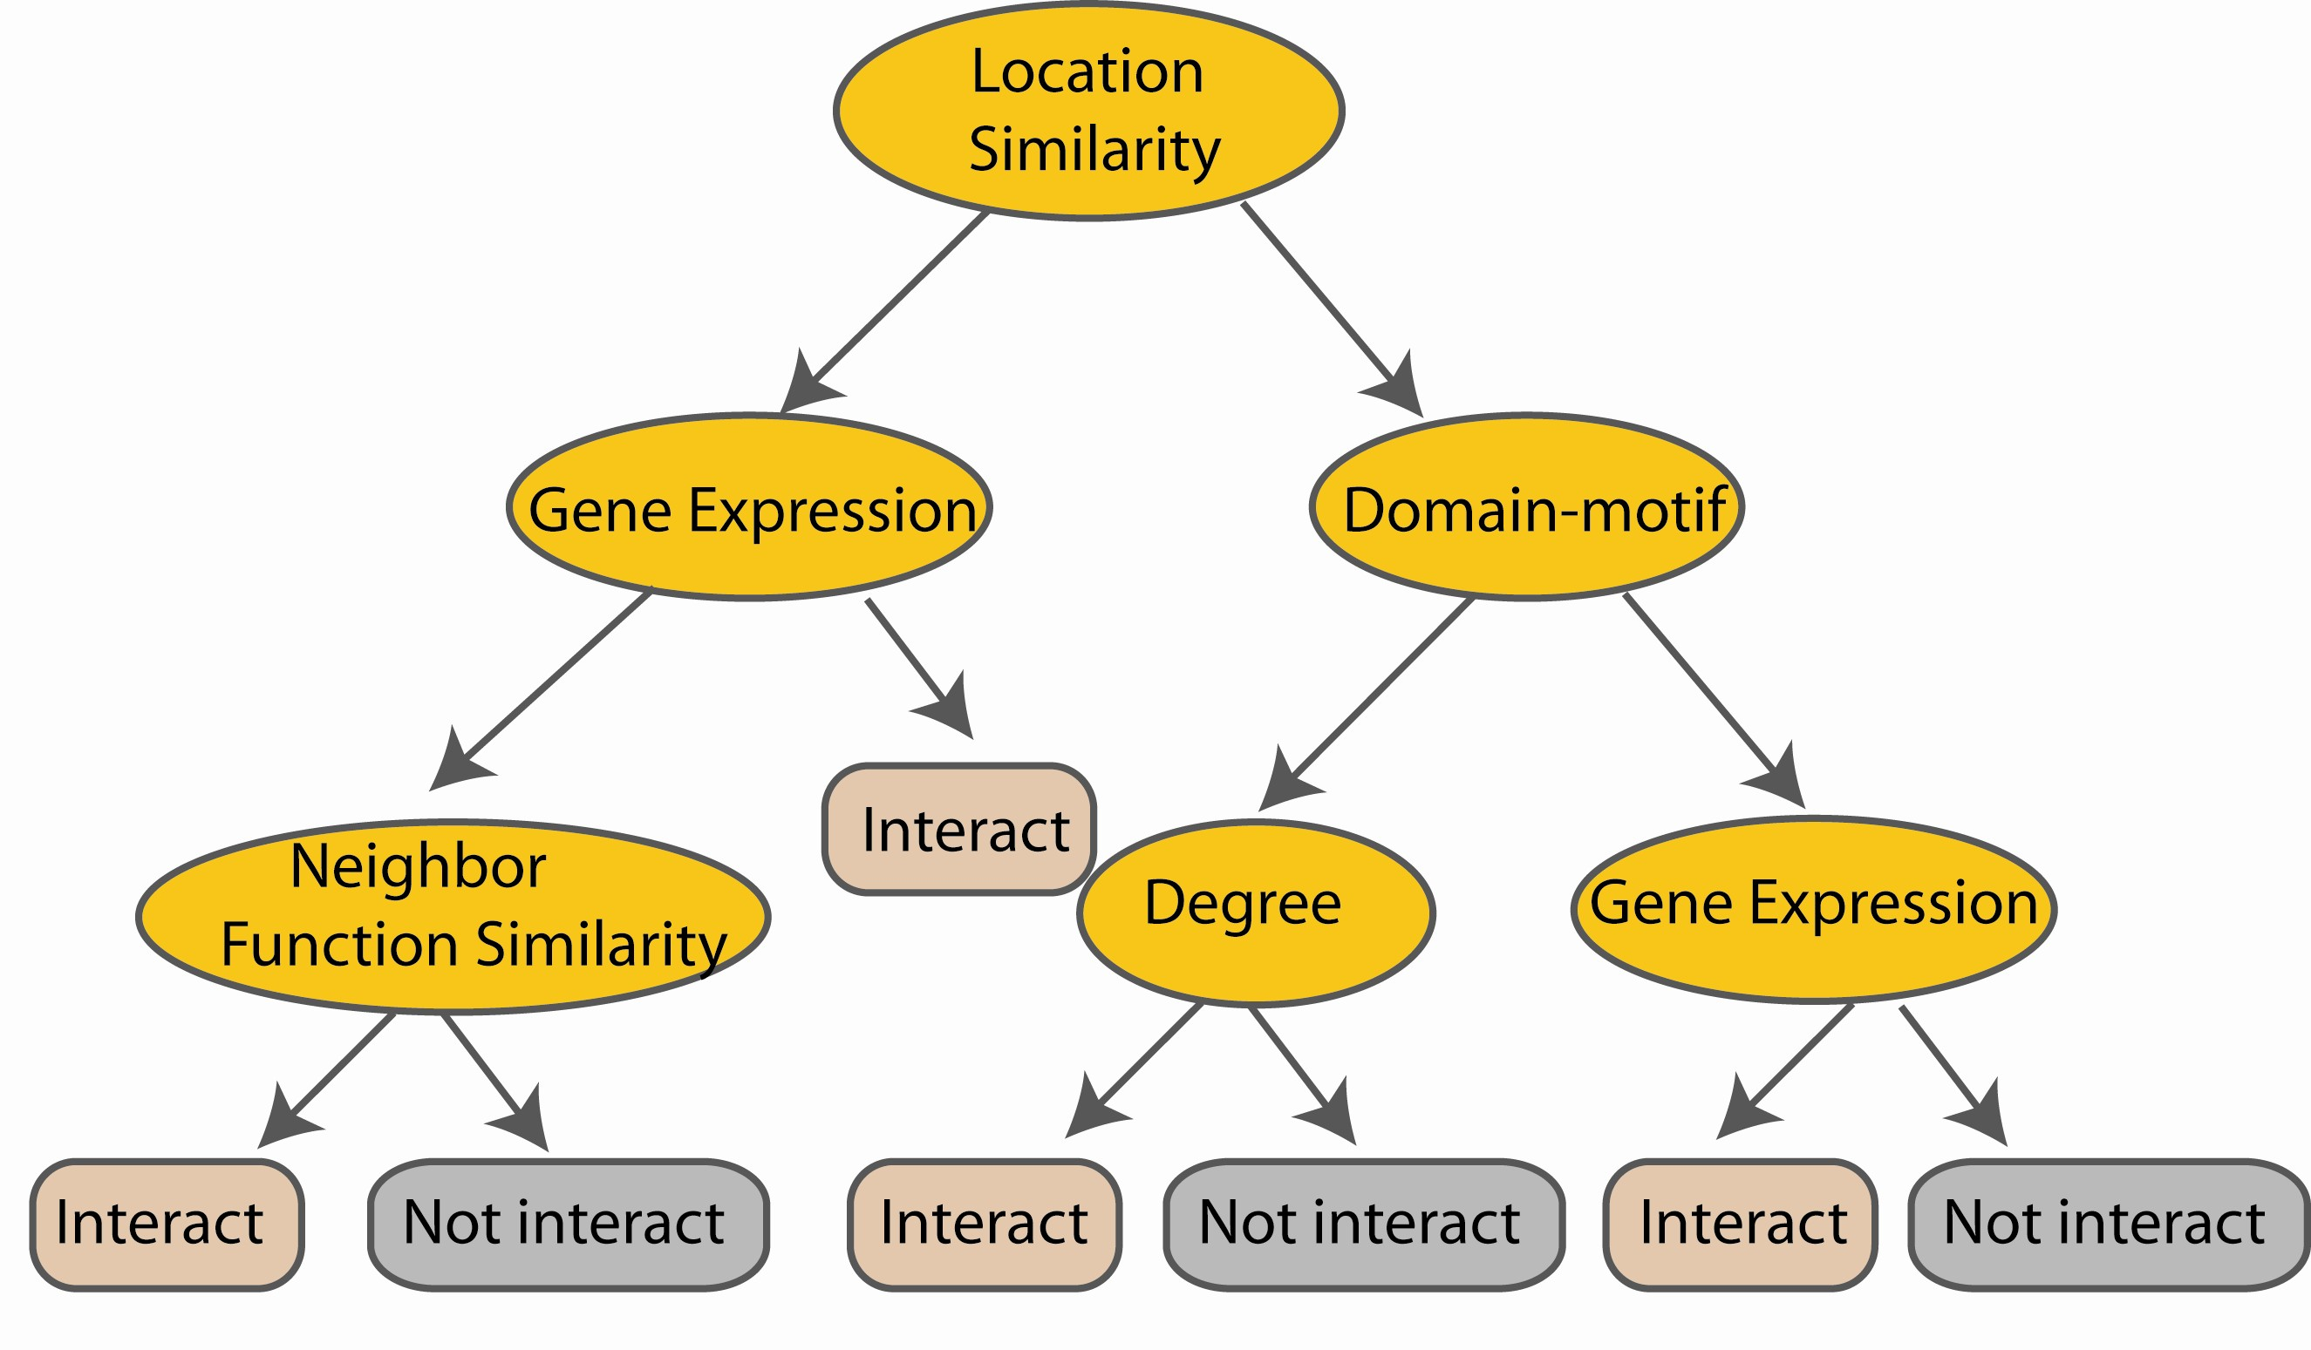
e.g., Decision Tree-building algorithms (1990s)
ID3: Iterative Dichotomiser 3. Developed in the 80s by Ross Quinlan.
C4.5: Successor of ID3, also developed by Quinlan (‘93). Main improvements over I3D:
Adaboost: by Robert Schapire (1999)

Slide 14

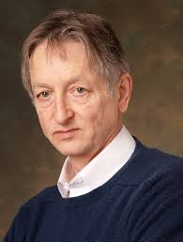

Connectionists
Yann LeCun
Geoff Hinton
Yoshua Bengio
Tribe | Origins | Key Algorithm
Connectionists | Neuroscience | Backpropagation

Slide 15
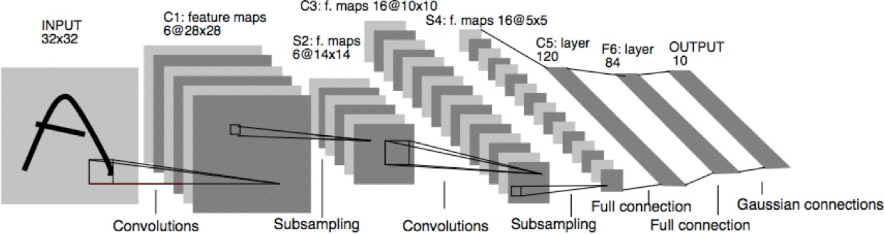
Deep Learning (CNN) in the 90’s
Prof. Yann LeCun invented Convolutional Neural Networks (CNN) in 1998
First NN successfully trained with many layers

Slide 16
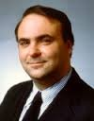
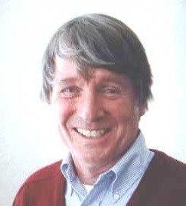
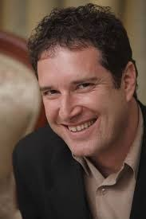
Evolutionists
John Koza
John Holland
Hod Lipson
Tribe | Origins | Key Algorithm
Evolutionists | Evolutionary biology | Genetic programming

Slide 17
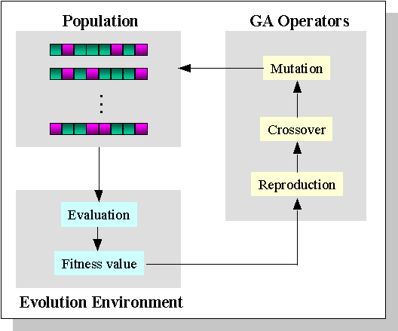
Genetic Algorithms

Slide 18

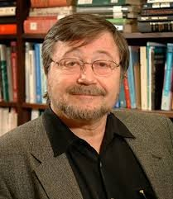
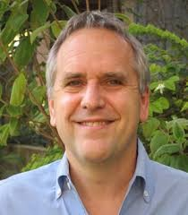
Bayesians
David Heckerman
Judea Pearl
Michael Jordan
Tribe | Origins | Key Algorithm
Bayesians | Statistics | Probabilistic inference

Slide 19
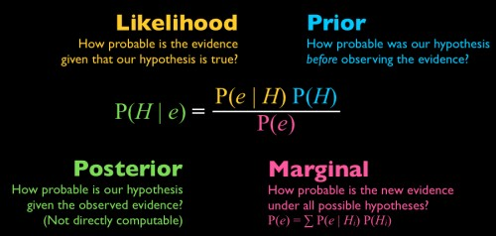
Probabilistic Inference

Slide 20
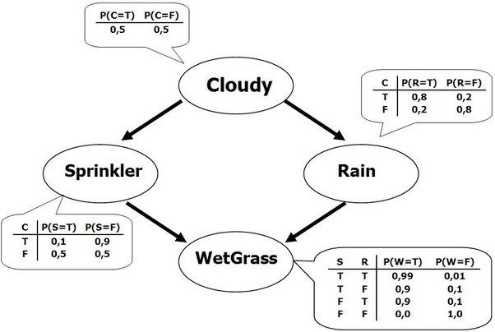
Reasoning with uncertainty
“Bayesian network” was termed by Judea Pearl in 1985
Bayes' conditioning is the basis for updating information in the graph
The distinction between causal and evidential modes of reasoning
In the late 1980s, established as a
field of study.
Pearl's Probabilistic Reasoning
in Intelligent Sy
Neapolitan's Probabilistic
Reasoning in Expert

Slide 21
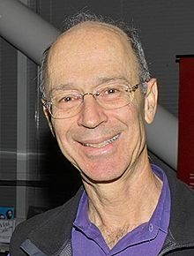
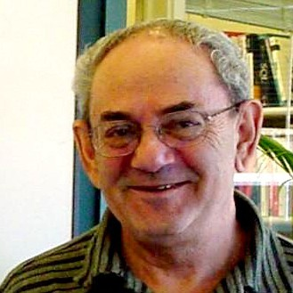

Analyzers
Peter Hart
Vladimir Vapnik
Douglas Hofstadter
Tribe | Origins | Key Algorithm
Analyzers | Psychology | Kernel machines

Slide 22
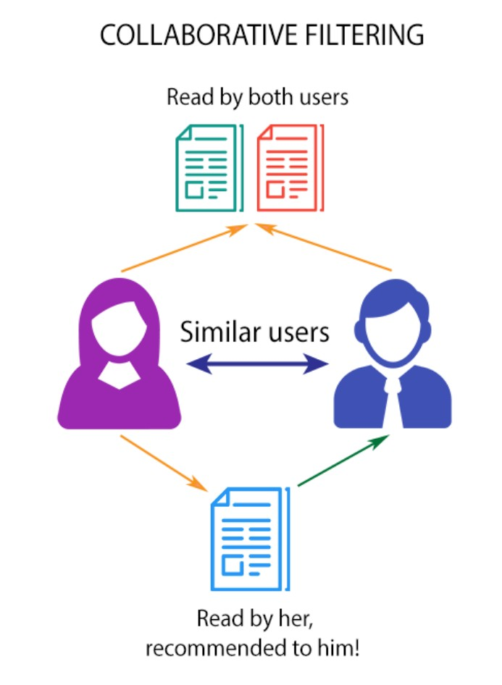
A little bit History
SVM : first introduced in 1992, popular because of its success in handwritten digit recognition (1994); Regarded as an important example of “kernel methods”
Recommender Systems:
E.g., Matrix Factorization

Slide 23

Recommender Systems

Slide 24
Summary of five tribes
Tribe | Problem | Origins | Solution | Module in Nutshell
Symbolists | Knowledge composition | Logic, philosophy | Inverse deduction | Representations;
Connectionists | Credit assignment | Neuroscience | Backpropagation | Representations; Numerical Optimization
Evolutionists | Search Structure discovery | Evolutionary biology | Genetic programming | Discrete Optimization;
Bayesians | Uncertainty | Statistics | Probabilistic inference | Likelihood type Score function;
Analyzers | Similarity | Psychology | Kernel machines | Representations; Reconstruction loss

Slide 25
Final Review
Five Tribes of Machine Learning
Review of ML methods covered so far
Regression (supervised)
Classification (supervised)
Unsupervised models
Learning theory

Slide 26
What we have covered (I)
Supervised Regression models
Linear regression (LR)
LR with non-linear basis functions
LR with Regularizations
Feature selection *

Slide 27
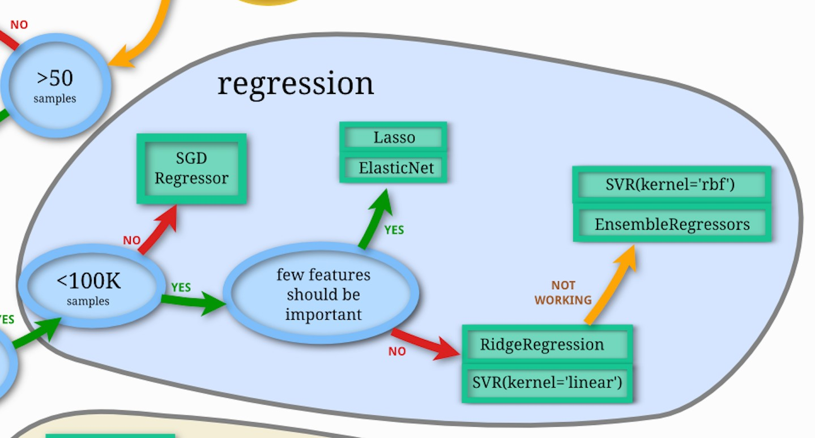
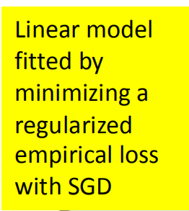
Scikit-learn : Regression

Slide 28
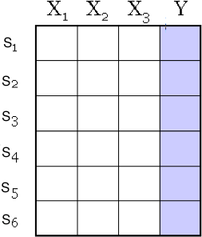
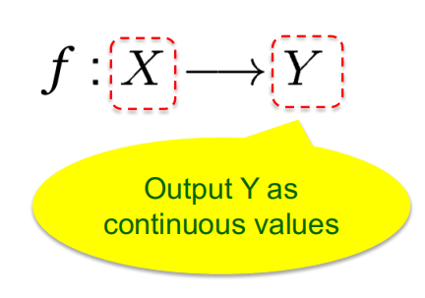
A Dataset
Data/points/instances/examples/samples/records: [ rows ]
Features/attributes/dimensions/independent variables/covariates/predictors/regressors: [ columns, except the last]
Target/outcome/response/label/dependent variable: special column to be predicted [ last column ]

Slide 29
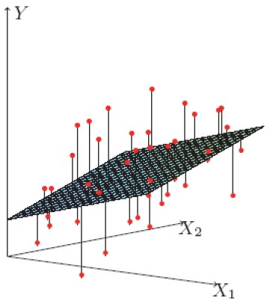
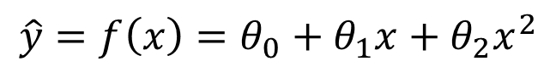
(1) Multivariate Linear Regression
Task
Regression
Representation
Y = Weighted linear sum of X’s
Score Function
Least-squares
Search/Optimization
Normal Eq / SGD / GD
Models, Parameters
Regression coefficients
$$\hat{y}=f\left(x\right)=θ_{0}+θ_{1}x+θ_{2}x^{2}$$
32

Slide 30
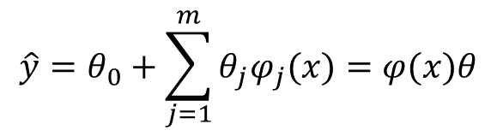
(2) Multivariate Linear Regression with basis Expansion
Task
Regression
Representation
Y = Weighted linear sum of (X basis expansion)
Score Function
Least-squares
Search/Optimization
Normal Eq / SGD / GD
Models, Parameters
Regression coefficients
$$\hat{y}=θ_{0}+\sum_{j=1}^{m}{θ_{j}φ_{j}(x)}=φ(x)θ$$

Slide 31
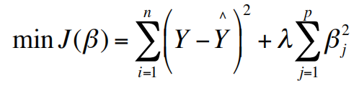
(3) Regularized multivariate linear regression
Task
Regression
Representation
Y = Weighted linear sum of X’s
Score Function
Least-squares+ Regularization -norm
Search/Optimization
Normal Eq / SGD / GD
Models, Parameters
Regularized Regression coefficients

Slide 32
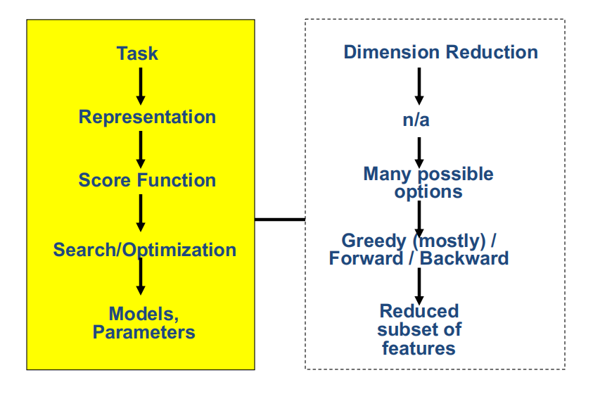
(4) Feature Selection

Slide 33
(4) Feature Selection
Thousands to millions of low level features.
select the most relevant ones to build better, faster, and easier to understand learning models.
p
X
n

Slide 34
Final Review
Five Tribes of Machine Learning
Review of ML methods covered so far
Regression (supervised)
Classification (supervised)
Unsupervised models
Learning theory

Slide 35
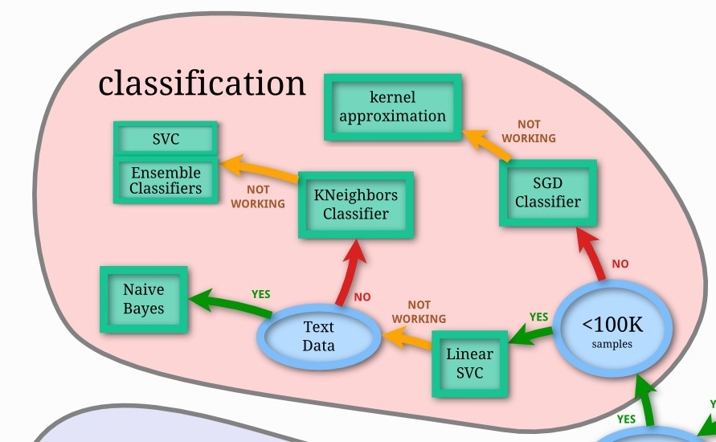










Scikit-learn: Classification
To combine the predictions of several base estimators built with a given learning algorithm in order to improve generalizability / robustness over a single estimator.
(1) averaging / bagging
(2) boosting
approximate the explicit feature mappings that correspond to certain kernels
Linear classifiers (SVM, logistic regression…) with SGD training.
12/4/19 38

Slide 36
What we have covered (II)
Supervised Classification models
K-nearest Neighbor
Support Vector Machine
Logistic Regression
Neural Network (e.g. MLP, CNN)
Generative Bayes Classifier (Naïve, Gaussian LDA, QDA)
Random forest / Decision Tree / Boosting

Slide 37
Three major sections for classification
We can divide the large variety of classification approaches into roughly three major types
Discriminative
directly estimate a decision rule/boundary
e.g., logistic regression, neural networks
e.g., support vector machine, decisionTrees
Generative:
build a generative statistical model
e.g., naïve bayes classifier, Bayesian networks
Instance based classifiers
Use observation directly (no models)
e.g. K nearest neighbors

Slide 38
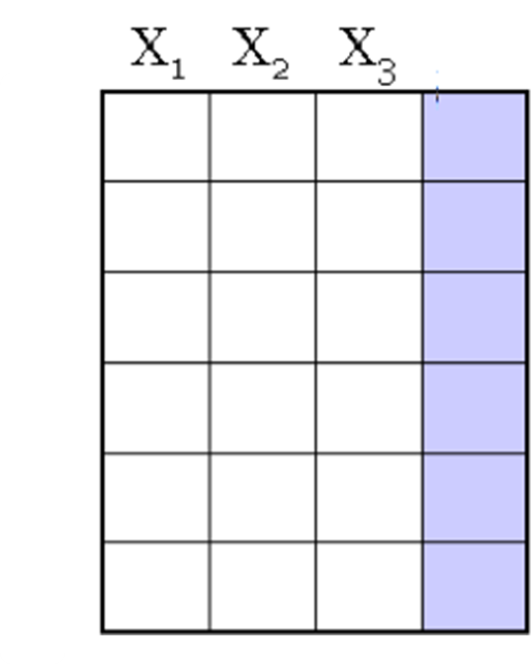
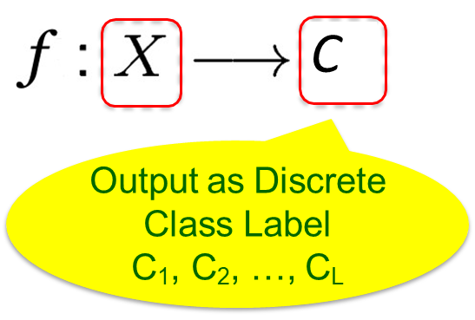
A Dataset for classification
Data/points/instances/examples/samples/records: [ rows ]
Features/attributes/dimensions/independent variables/covariates/predictors/regressors: [ columns, except the last]
Target/outcome/response/label/dependent variable: special column to be predicted [ last column ]

Slide 39
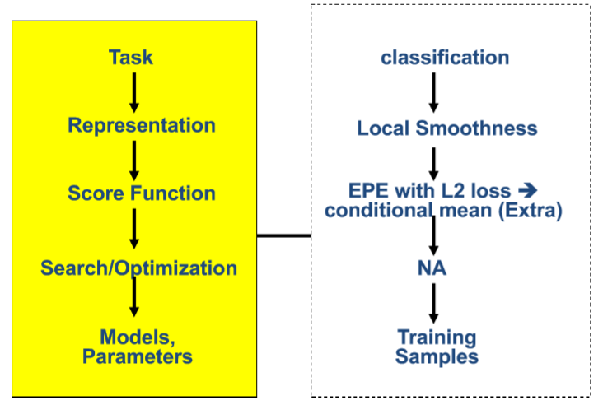
(1) K-Nearest Neighbor

Slide 40
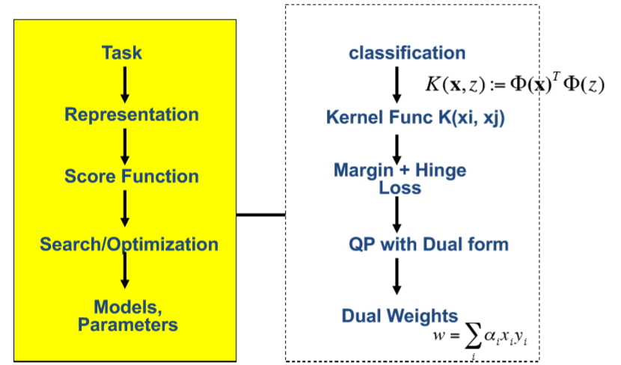
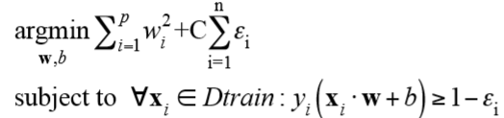
(2) Support Vector Machine

Slide 41
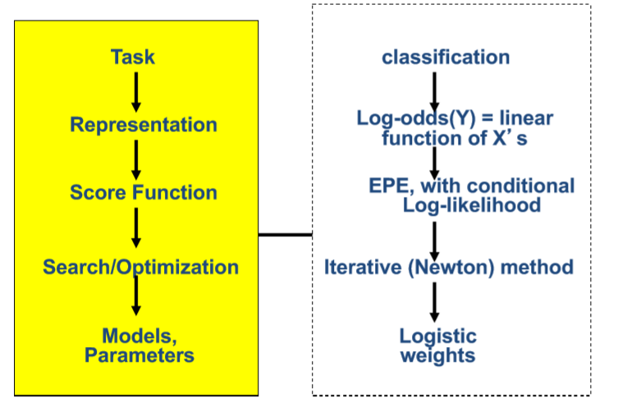
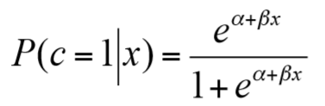
(3) Logistic Regression

Slide 42
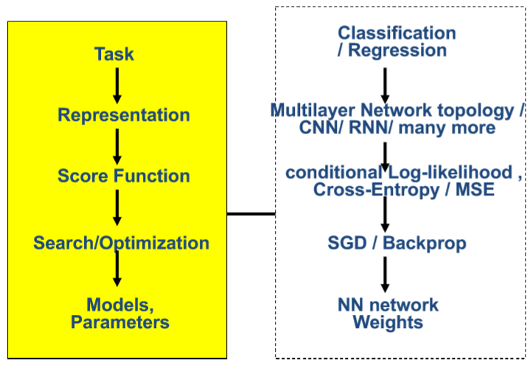
(4) Neural Network

Slide 43
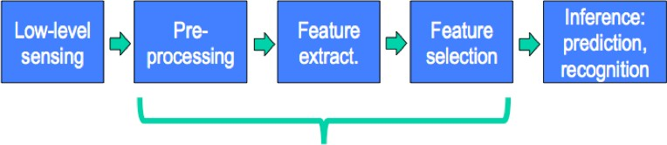
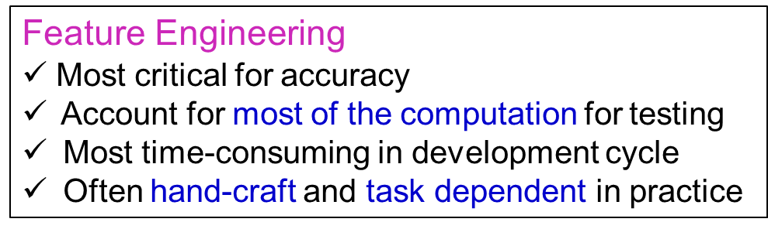
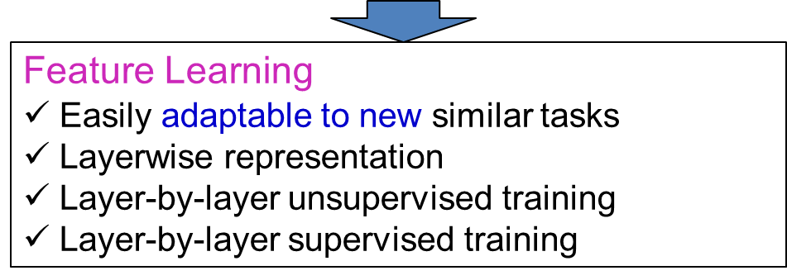
Deep Learning Way: Learning features / Representation from data

Slide 44
Some Recent DNN Trends
1. CNN / Residual / Dynamic parameter
2. RNN / Attention / Seq2Seq / BERT …
3. Neural Architecture with explicit Memory
4. Learning to optimize / Learning DNN architectures
5. Autoencoder / layer-wise training
6. Learning to learn / meta-learning/ few-shots
7. DNN on graphs / trees / sets
8. NTM 4program induction / sequential decisions
9. Generative Adversarial Networks (GAN)
10. Deep Generative models, e.g., autoregressive
11. Deep reinforcement learning
12. Validate / Evade / Test / Understand / Verify DNNs
New Network topology
New Losses
New Inputs
New Tasks
New Model Properties

Slide 45
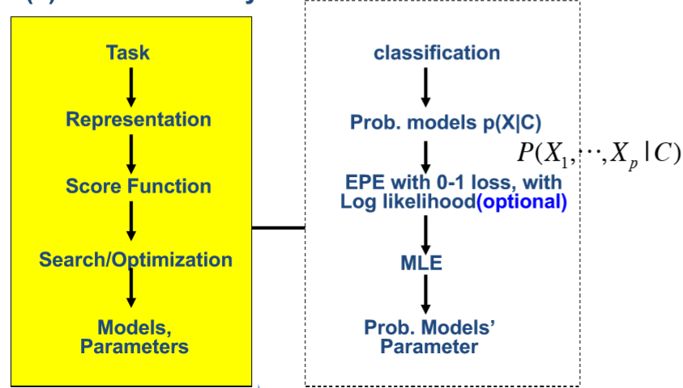
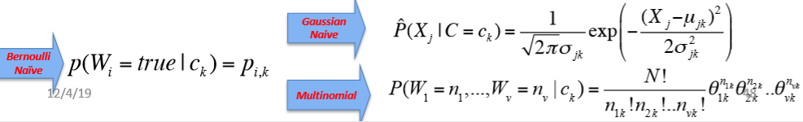
(5) Generative Bayes Classifier

Slide 46
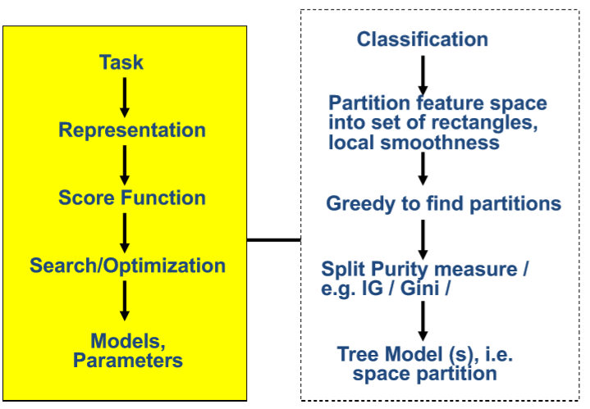
(6) Decision Tree / Bagging DT

Slide 47
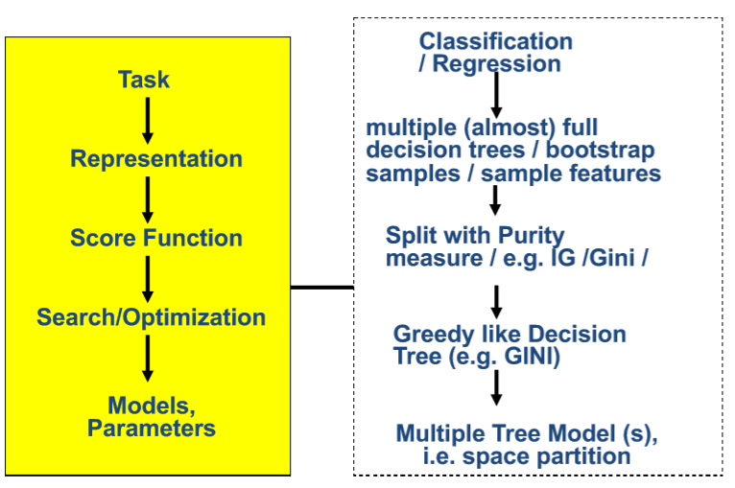
(7) Random Forest

Slide 48
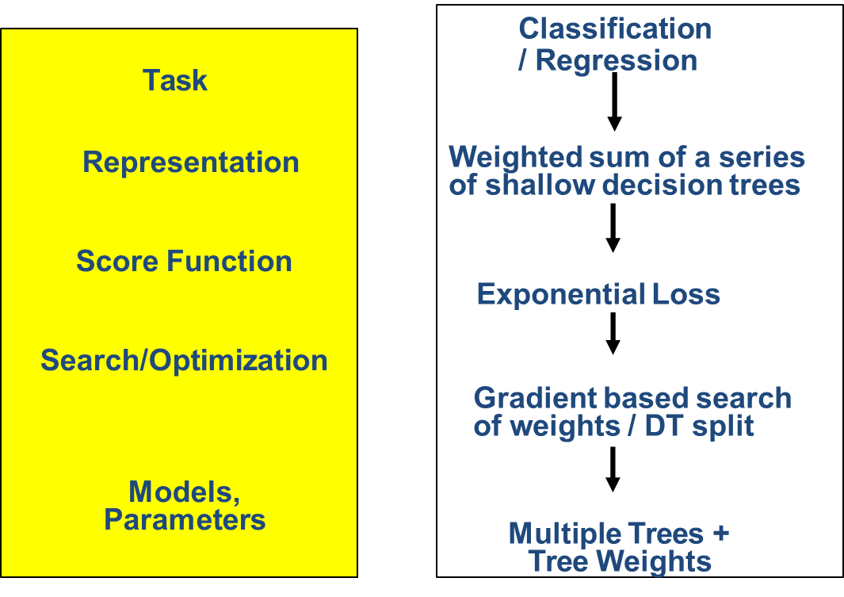
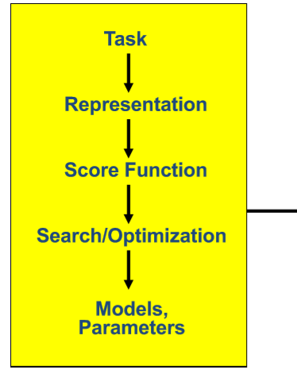
(8) Boosting

Slide 49
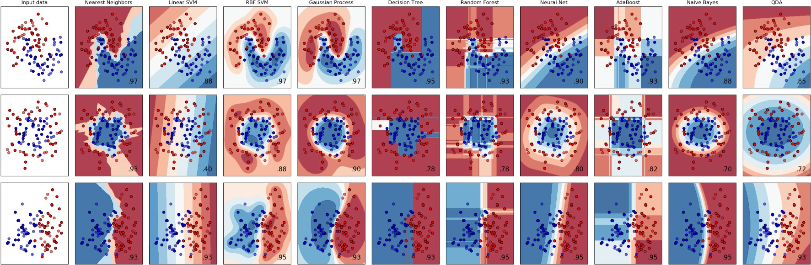
different assumptions on data
different scalability profiles at training time
different latencies at prediction (test) time
different model sizes (embedability in mobile devices)
different level of model interpretability

Slide 50
Final Review
Five Tribes of Machine Learning
Review of ML methods covered so far
Regression (supervised)
Classification (supervised)
Unsupervised models
Learning theory

Slide 51
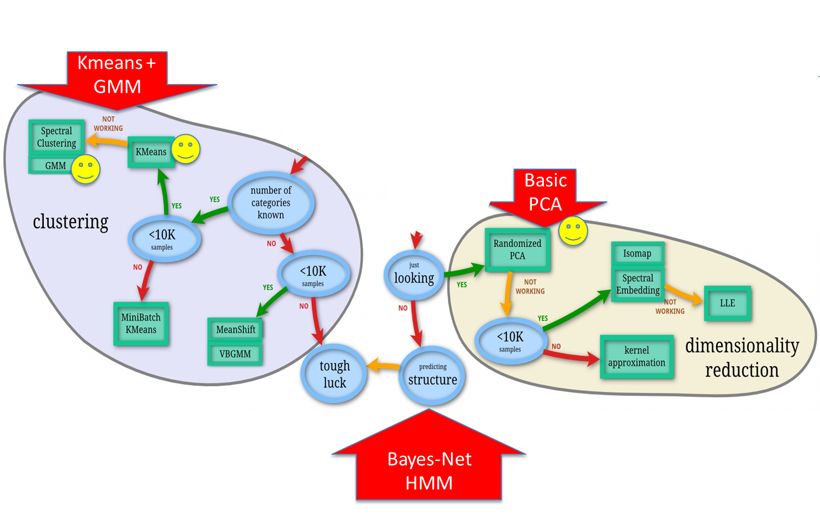
Then after classification

Slide 52
What we have covered (III)
Unsupervised models
Dimension Reduction (PCA)
Hierarchical clustering
K-means clustering
GMM/EM clustering

Slide 53
An unlabeled
Dataset X
a data matrix of n observations on
p variables x₁,x₂,…x_{p}
Unsupervised learning = learning from raw (unlabeled, unannotated, etc) data, as opposed to supervised data where a label of examples is given
Data/points/instances/examples/samples/records: [ rows ]
Features/attributes/dimensions/independent variables/covariates/predictors/regressors: [ columns]

Slide 54
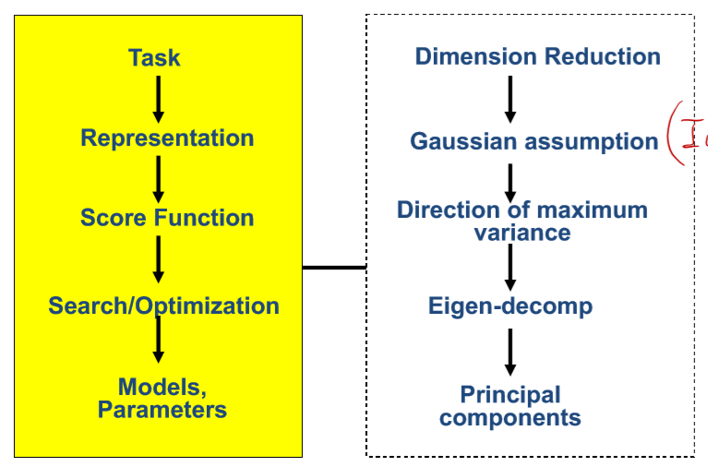
(1) Principal Component Analysis (optional)

Slide 55

Reconstruction Loss :
auto-encoder-decoder is trained to reproduce the input

Slide 56

(2) Hierarchical Clustering

Slide 57

(3) K-means Clustering

Slide 58


(4) GMM Clustering

Slide 59

different assumptions on data
different scalability profiles
different model sizes (embedability in mobile devices)

Slide 60
Final Review
Five Tribes of Machine Learning
Review of ML methods covered so far
Regression (supervised)
Classification (supervised)
Unsupervised models
Learning theory

Slide 61
What we have covered (IV)
Learning theory / Model selection
K-folds cross validation
Expected prediction error
Bias and variance tradeoff
Generative vs. Discriminative Classifiers

Slide 63

CV-based Model Selection
We’re trying to decide which algorithm / hyperparameter to use.
We train each model and make a table...
Hyperparameter tuning ….

Slide 64
Bias-Variance Trade-off for EPE
Expected prediction error (EPE):
EPE = noise² + bias² + variance
Unavoidable error
Error due to incorrect assumptions
Error due to variance of training samples

Slide 65


Recap: Bias-Variance Tradeoff / Model Selection
underfit region
overfit region

Slide 66
Logistic Regression vs. Naïve/ LDA
Discriminative classifier (Logistic Regression)
Smaller asymptotic error
Slow convergence ~O(p)
Generative classifier (Naive Bayes)
Larger asymptotic error
Can handle missing data (EM)
Fast convergence ~ O(lg(p))
the speed at which a convergent sequence approaches its limit is called the rate of convergence.

Slide 67
What we have covered for each component
Task Regression, classification, clustering, dimen-reduction
Representation
Linear func, nonlinear function (e.g. polynomial expansion), local linear, logistic function (e.g. p(c|x)), tree, multi-layer, prob-density family (e.g. Bernoulli, multinomial, Gaussian, mixture of Gaussians), local func smoothness, kernel matrix, local smoothness, partition of feature space,
Score Function
MSE, Margin, log-likelihood, EPE (e.g. L2 loss for KNN, 0-1 loss for Bayes classifier), cross-entropy, cluster points distance to centers, variance, conditional log-likelihood, complete data-likelihood, regularized loss func (e.g. L1, L2) , goodness of inter-cluster similar
Search/ Optimization
Normal equation, gradient descent, stochastic GD, Newton, Linear programming, Quadratic programming (quadratic objective with linear constraints), greedy, EM, asyn-SGD, eigenDecomp, backprop
Models, Parameters
Linear weight vector, basis weight vector, local weight vector, dual weights, training samples, tree-dendrogram, multi-layer weights, principle components, member (soft/hard) assignment, cluster centroid, cluster covariance (shape), …
70

Slide 68
Thanks for listening

